Slide 1
EENG 284 - Lab 11 Control + Datapath + RAM

Slide 2
Load and Store
LD R3, R2 // Copy value at RAM address in R2 to R3
ADD 1, R2, R2 // Add 1 to R2 – not a legal line of code
ST R3, R2 // Copy R3 to RAM address given in R2
RAM contents | RAM address
 | 20
 | 21
 | 22
0X1234
R2 = 20
0X1234
R3 =1234
R2 = 21
R3 contents is stored at memory location at R2 =1234

Slide 3
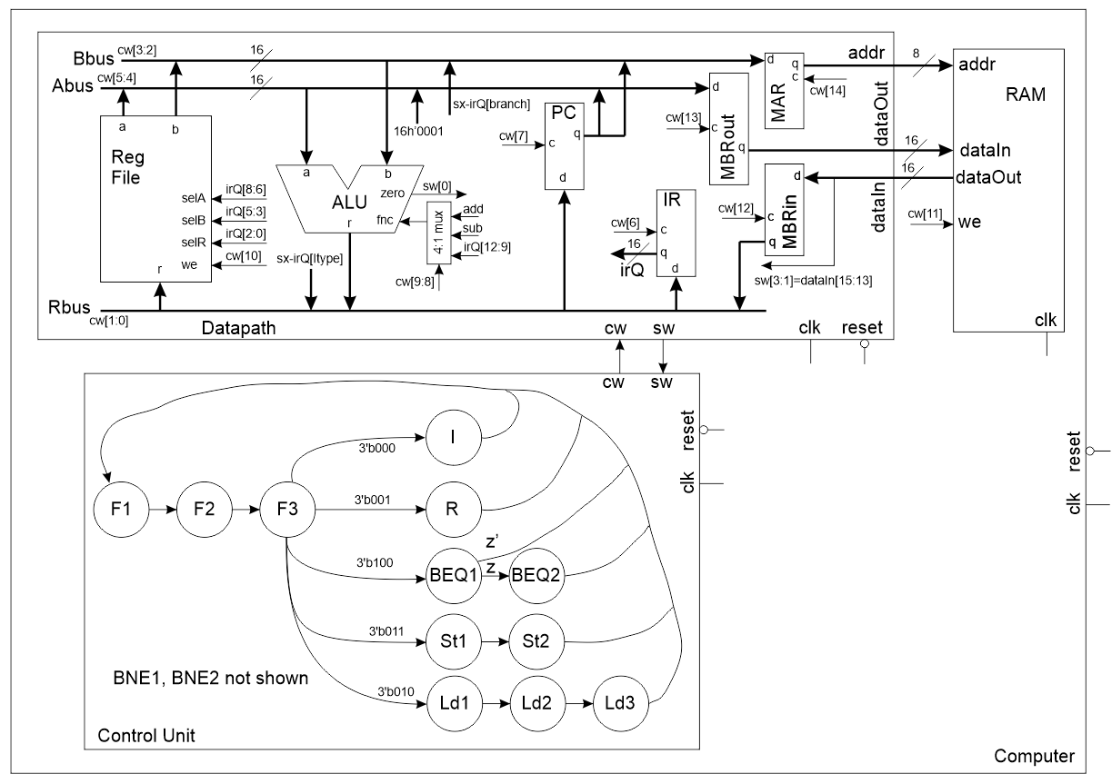
Control + Datapath + RAM

Slide 4
Instructions
Load from memory ADDR to register DST
Store register SRC to memory ADDR
 |  | 15 | 14 | 13 | 12 | 11 | 10 | 9 | 8 | 7 | 6 | 5 | 4 | 3 | 2 | 1 | 0
R-type |  | b001 |  |  | Func |  |  |  | SRC1 |  |  | SRC2 |  |  | DST
Load Immediate |  | b000 |  |  |  |  | Immediate |  |  |  |  |  |  |  | DST
BEQ/BNE |  | b100/b101 |  |  | Offset - MS |  |  |  | SRC1 |  |  | SRC2 |  |  | Offset - LS
Store |  | b011 |  |  | Don’t care |  |  |  | SRC |  |  | ADDR |  |  | Don’t Care
Load |  | b010 |  |  | Don't care |  |  |  |  |  |  | ADDR |  |  | DST

Slide 5
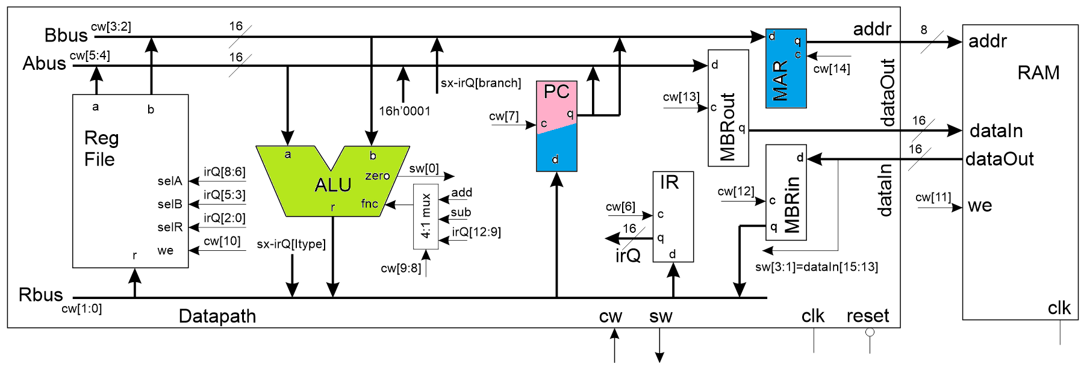
The Control Word Fetch 1
 | 14 | 13 | 12 | 11 | 10 | 9,8 | 7 | 6 | 5,4 | 3,2 | 1,0
Code | MAR | MBRout | MBRin | RAM WE | RF WE | ALU | PC | IR | ABUS | BBUS | RBUS
00 or 0 | hold | hold | hold | no write | No | IR[12:9] | Hold | Hold | RFa | RFb | MBR
1 |  |  |  |  |  |  |  |  | 0x01
10 |  |  |  |  |  | Sub |  |  |  | IR[BR] | IR[IMM]
11 or 1 | load | load | load | write | Write | Add | Load | Load | PC | PC | ALU

Slide 6
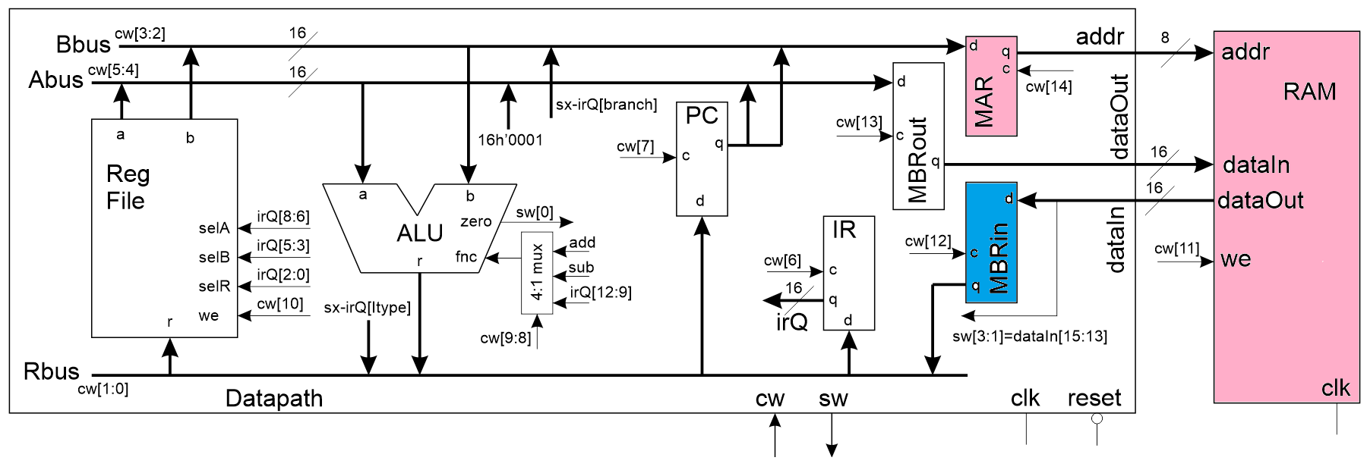
The Control Word Fetch 2
 | 14 | 13 | 12 | 11 | 10 | 9,8 | 7 | 6 | 5,4 | 3,2 | 1,0
Code | MAR | MBRout | MBRin | RAM WE | RF WE | ALU | PC | IR | ABUS | BBUS | RBUS
00 or 0 | hold | hold | hold | no write | No | IR[12:9] | Hold | Hold | RFa | RFb | MBR
1 |  |  |  |  |  |  |  |  | 0x01
10 |  |  |  |  |  | Sub |  |  |  | IR[BR] | IR[IMM]
11 or 1 | load | load | load | write | Write | Add | Load | Load | PC | PC | ALU

Slide 7
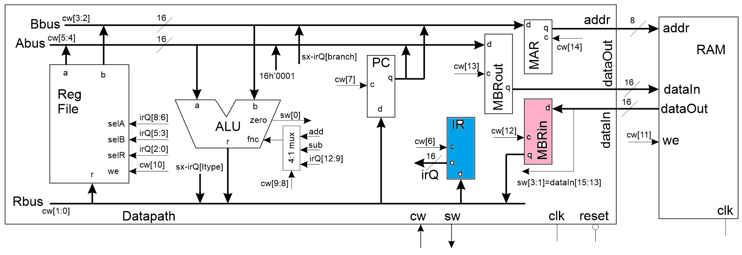
The Control Word Fetch 3
 | 14 | 13 | 12 | 11 | 10 | 9,8 | 7 | 6 | 5,4 | 3,2 | 1,0
Code | MAR | MBRout | MBRin | RAM WE | RF WE | ALU | PC | IR | ABUS | BBUS | RBUS
00 or 0 | hold | hold | hold | no write | No | IR[12:9] | Hold | Hold | RFa | RFb | MBR
1 |  |  |  |  |  |  |  |  | 0x01
10 |  |  |  |  |  | Sub |  |  |  | IR[BR] | IR[IMM]
11 or 1 | load | load | load | write | Write | Add | Load | Load | PC | PC | ALU

Slide 8
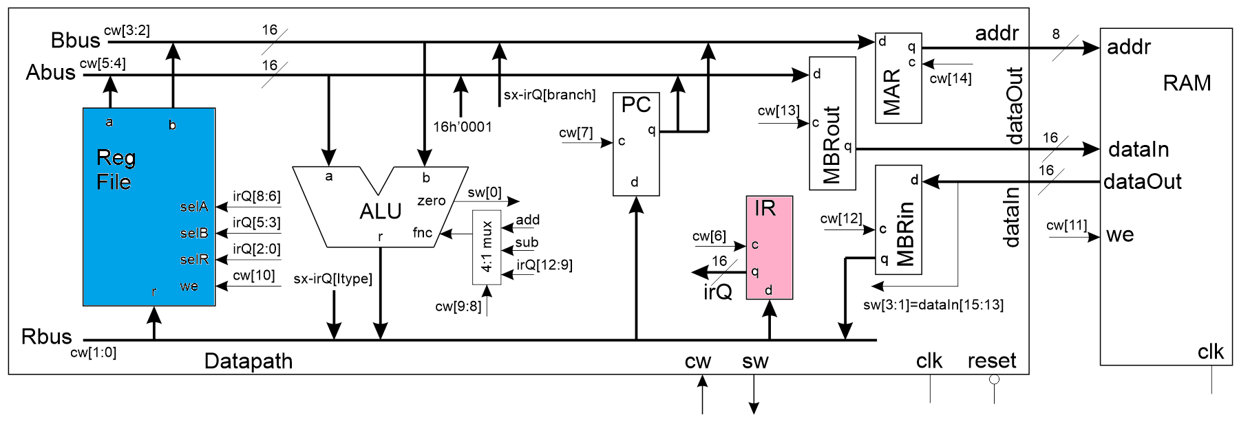
The Control Word I-type
 | 14 | 13 | 12 | 11 | 10 | 9,8 | 7 | 6 | 5,4 | 3,2 | 1,0
Code | MAR | MBRout | MBRin | RAM WE | RF WE | ALU | PC | IR | ABUS | BBUS | RBUS
00 or 0 | hold | hold | hold | no write | No | IR[12:9] | Hold | Hold | RFa | RFb | MBR
1 |  |  |  |  |  |  |  |  | 0x01
10 |  |  |  |  |  | Sub |  |  |  | IR[BR] | IR[IMM]
11 or 1 | load | load | load | write | Write | Add | Load | Load | PC | PC | ALU

Slide 9
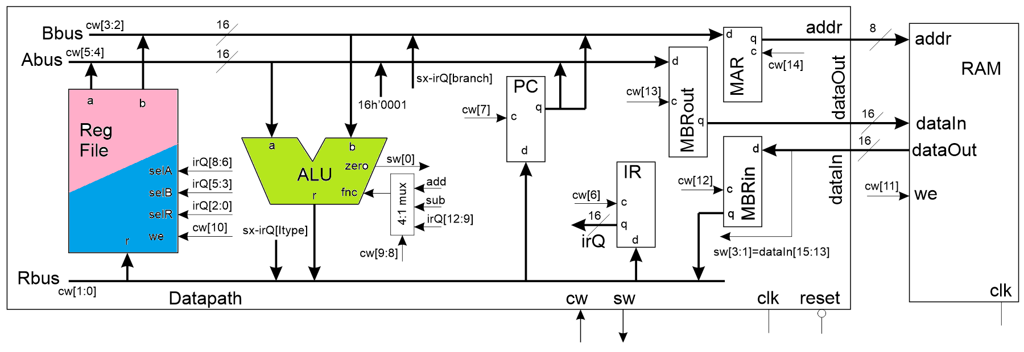
The Control Word R-type
 | 14 | 13 | 12 | 11 | 10 | 9,8 | 7 | 6 | 5,4 | 3,2 | 1,0
Code | MAR | MBRout | MBRin | RAM WE | RF WE | ALU | PC | IR | ABUS | BBUS | RBUS
00 or 0 | hold | hold | hold | no write | No | IR[12:9] | Hold | Hold | RFa | RFb | MBR
1 |  |  |  |  |  |  |  |  | 0x01
10 |  |  |  |  |  | Sub |  |  |  | IR[BR] | IR[IMM]
11 or 1 | load | load | load | write | Write | Add | Load | Load | PC | PC | ALU

Slide 10
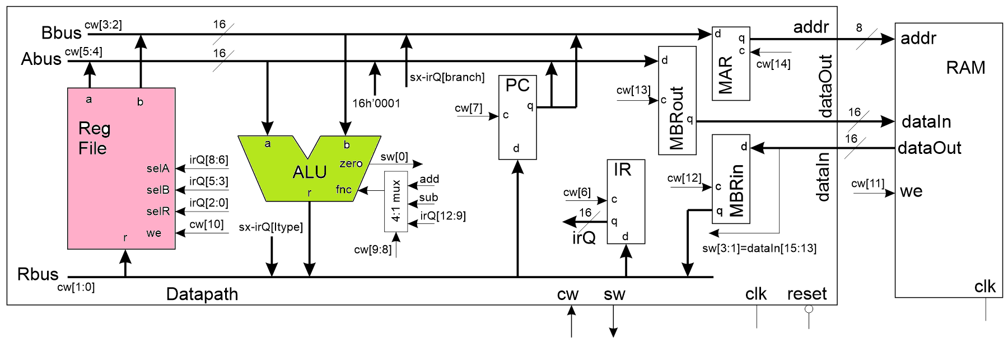
The Control Word Branch 1
 | 14 | 13 | 12 | 11 | 10 | 9,8 | 7 | 6 | 5,4 | 3,2 | 1,0
Code | MAR | MBRout | MBRin | RAM WE | RF WE | ALU | PC | IR | ABUS | BBUS | RBUS
00 or 0 | hold | hold | hold | no write | No | IR[12:9] | Hold | Hold | RFa | RFb | MBR
1 |  |  |  |  |  |  |  |  | 0x01
10 |  |  |  |  |  | Sub |  |  |  | IR[BR] | IR[IMM]
11 or 1 | load | load | load | write | Write | Add | Load | Load | PC | PC | ALU

Slide 11
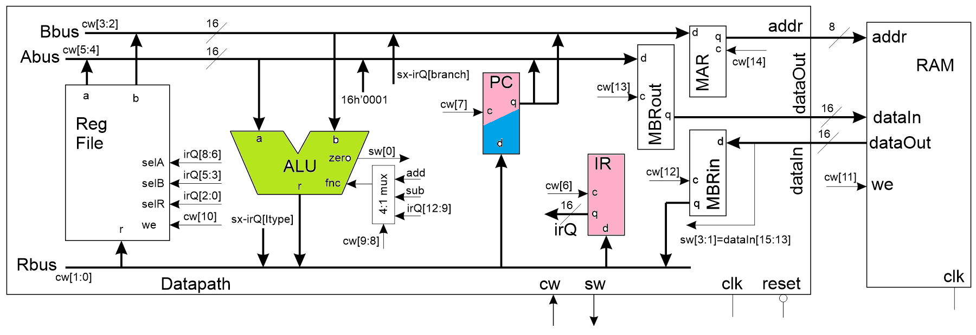
The Control Word Branch 2
 | 14 | 13 | 12 | 11 | 10 | 9,8 | 7 | 6 | 5,4 | 3,2 | 1,0
Code | MAR | MBRout | MBRin | RAM WE | RF WE | ALU | PC | IR | ABUS | BBUS | RBUS
00 or 0 | hold | hold | hold | no write | No | IR[12:9] | Hold | Hold | RFa | RFb | MBR
1 |  |  |  |  |  |  |  |  | 0x01
10 |  |  |  |  |  | Sub |  |  |  | IR[BR] | IR[IMM]
11 or 1 | load | load | load | write | Write | Add | Load | Load | PC | PC | ALU

Slide 12
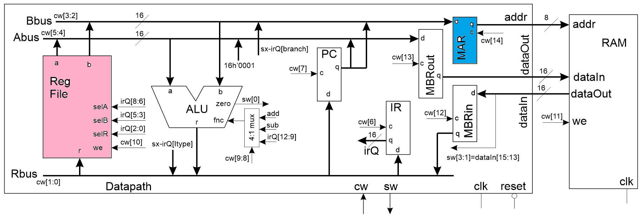
The Control Word Load 1
 | 14 | 13 | 12 | 11 | 10 | 9,8 | 7 | 6 | 5,4 | 3,2 | 1,0
Code | MAR | MBRout | MBRin | RAM WE | RF WE | ALU | PC | IR | ABUS | BBUS | RBUS
00 or 0 | hold | hold | hold | no write | No | IR[12:9] | Hold | Hold | RFa | RFb | MBR
1 |  |  |  |  |  |  |  |  | 0x01
10 |  |  |  |  |  | Sub |  |  |  | IR[BR] | IR[IMM]
11 or 1 | load | load | load | write | Write | Add | Load | Load | PC | PC | ALU

Slide 13
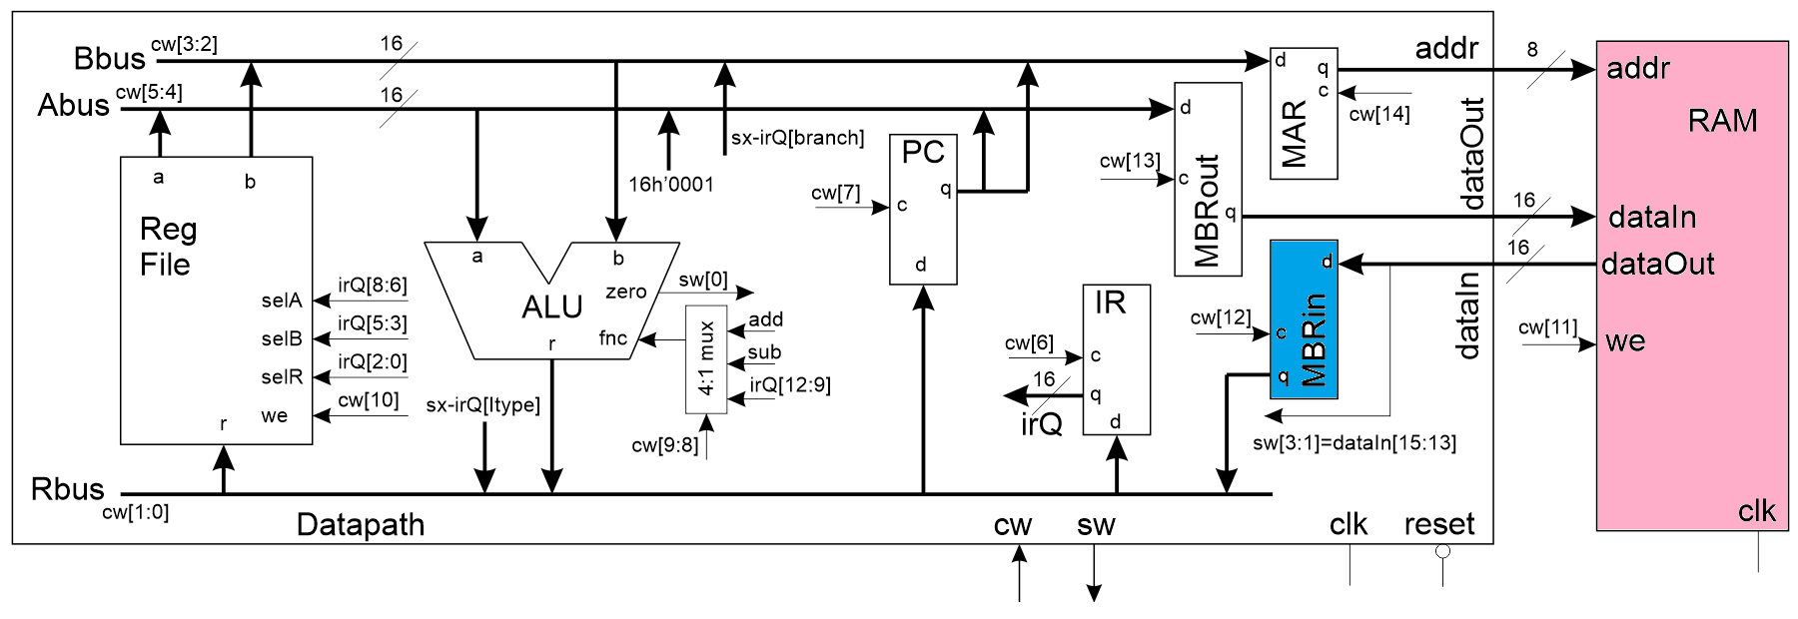
The Control Word Load 2
 | 14 | 13 | 12 | 11 | 10 | 9,8 | 7 | 6 | 5,4 | 3,2 | 1,0
Code | MAR | MBRout | MBRin | RAM WE | RF WE | ALU | PC | IR | ABUS | BBUS | RBUS
00 or 0 | hold | hold | hold | no write | No | IR[12:9] | Hold | Hold | RFa | RFb | MBR
1 |  |  |  |  |  |  |  |  | 0x01
10 |  |  |  |  |  | Sub |  |  |  | IR[BR] | IR[IMM]
11 or 1 | load | load | load | write | Write | Add | Load | Load | PC | PC | ALU

Slide 14
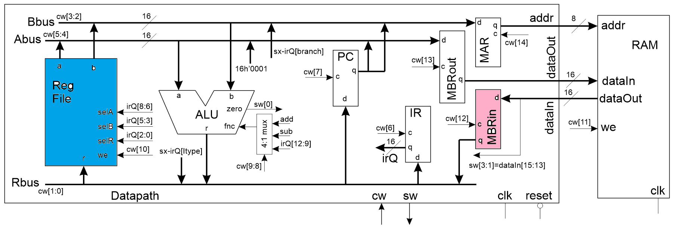
The Control Word Load 3
 | 14 | 13 | 12 | 11 | 10 | 9,8 | 7 | 6 | 5,4 | 3,2 | 1,0
Code | MAR | MBRout | MBRin | RAM WE | RF WE | ALU | PC | IR | ABUS | BBUS | RBUS
00 or 0 | hold | hold | hold | no write | No | IR[12:9] | Hold | Hold | RFa | RFb | MBR
1 |  |  |  |  |  |  |  |  | 0x01
10 |  |  |  |  |  | Sub |  |  |  | IR[BR] | IR[IMM]
11 or 1 | load | load | load | write | Write | Add | Load | Load | PC | PC | ALU

Slide 15
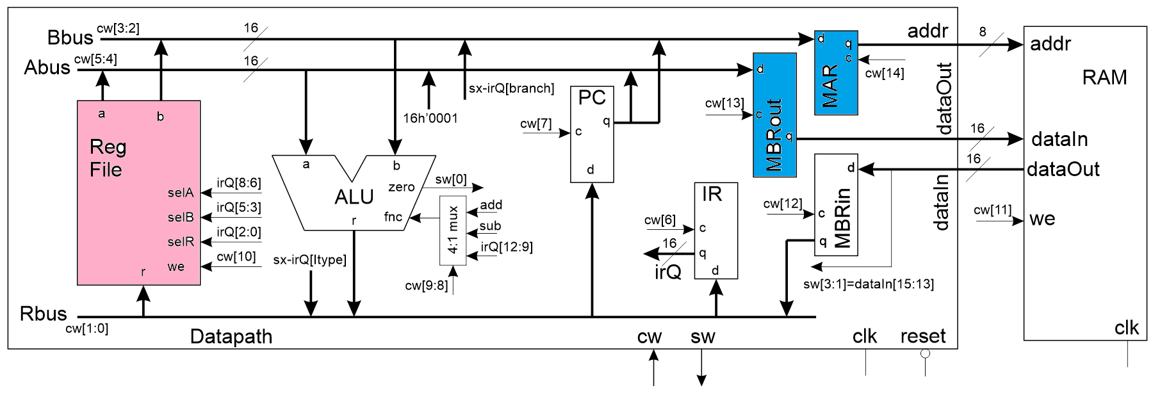
The Control Word Store 1
 | 14 | 13 | 12 | 11 | 10 | 9,8 | 7 | 6 | 5,4 | 3,2 | 1,0
Code | MAR | MBRout | MBRin | RAM WE | RF WE | ALU | PC | IR | ABUS | BBUS | RBUS
00 or 0 | hold | hold | hold | no write | No | IR[12:9] | Hold | Hold | RFa | RFb | MBR
1 |  |  |  |  |  |  |  |  | 0x01
10 |  |  |  |  |  | Sub |  |  |  | IR[BR] | IR[IMM]
11 or 1 | load | load | load | write | Write | Add | Load | Load | PC | PC | ALU

Slide 16
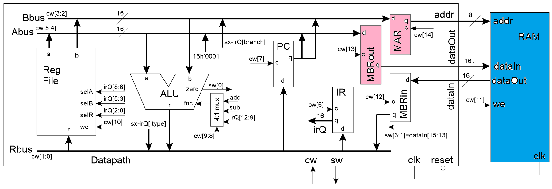
The Control Word Store 2
 | 14 | 13 | 12 | 11 | 10 | 9,8 | 7 | 6 | 5,4 | 3,2 | 1,0
Code | MAR | MBRout | MBRin | RAM WE | RF WE | ALU | PC | IR | ABUS | BBUS | RBUS
00 or 0 | hold | hold | hold | no write | No | IR[12:9] | Hold | Hold | RFa | RFb | MBR
1 |  |  |  |  |  |  |  |  | 0x01
10 |  |  |  |  |  | Sub |  |  |  | IR[BR] | IR[IMM]
11 or 1 | load | load | load | write | Write | Add | Load | Load | PC | PC | ALU

Slide 17
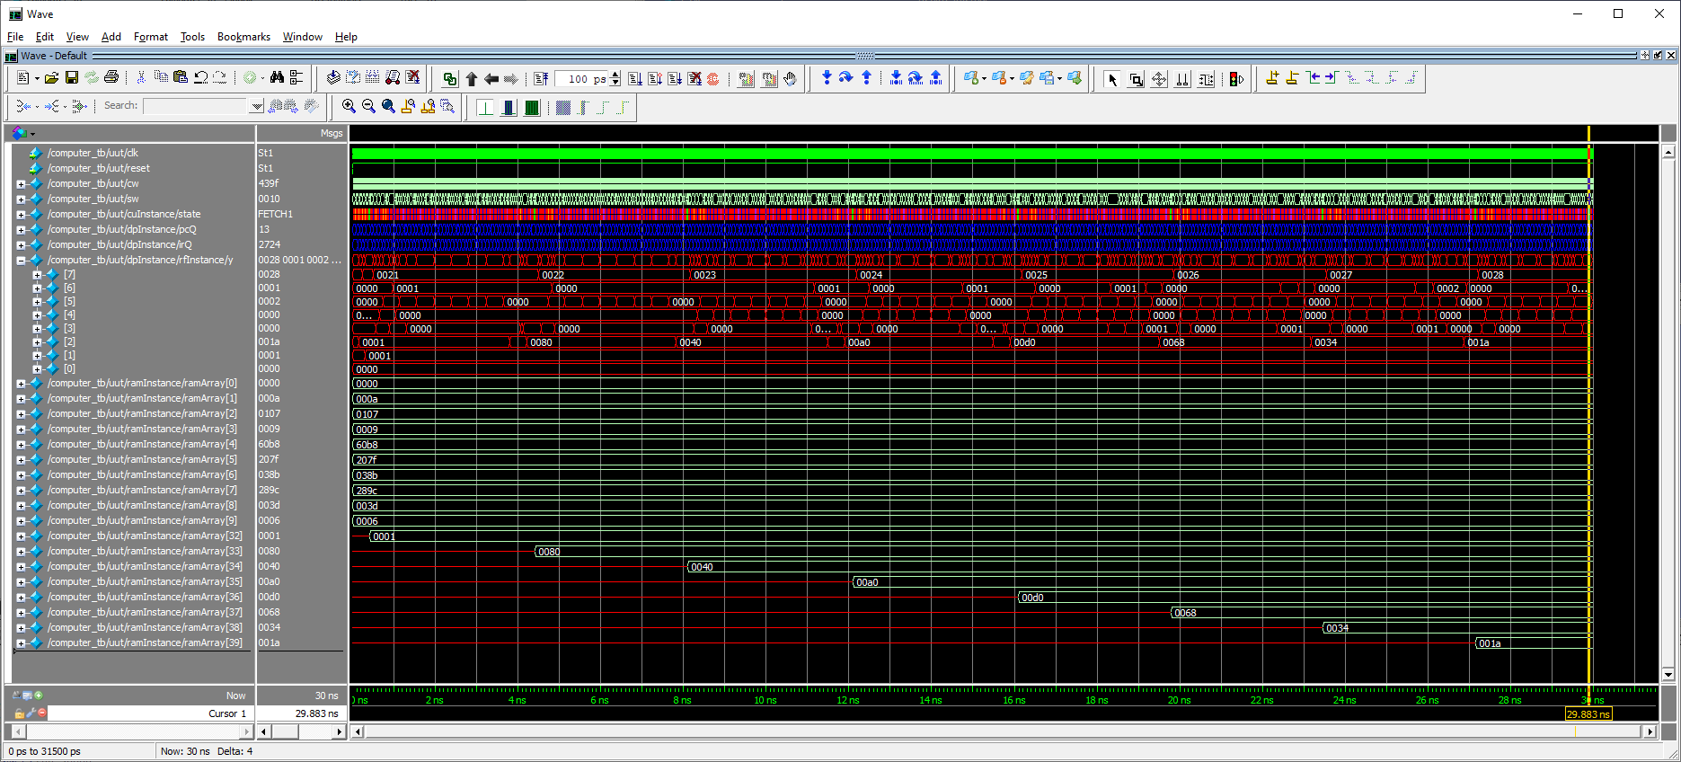
Deliverables
Computer testbench running 8-bit LFSR

